Slide 1
Optimized Sequential Synthesis with an application to legal anonymization
Cameron Bale
Joint work with Harrison Quick

Slide 2
Motivations
Make Data Synthesis Easier
Enhance Understanding of Legal Anonymization

Slide 3
Problem: Tuning Synthesis Models is Tedious
$$U\left(Z\right)=u_{Z}$$
$$R\left(Z\right)=r_{Z}$$
Data utility and privacy risk measures
$$𝒮\left(Y, θ\right)=Z$$
$$θ^{new}$$
Data steward chooses $θ^{new}$ to balance $u_{Z}$ and $r_{Z}$
Notes:
Really, there are a lot of things that make tuning synthesis models difficult. It requires technical expertise to know how to adjust models to adjust level of ‘fit’, it can be expensive or limited if you pay a company to do it, it can take a lot of time and adjustment of models even if you know what you’re doing. It’s definitely doable, but to do it effectively takes resources that a lot of potential users of the method may not have.

Slide 4
Solution: Optimized Sequential Synthesis Method that Automatically Chooses $θ^{new}$
$$U\left(Z\right)=u_{Z}$$
$$R\left(Z\right)=r_{Z}$$
$$𝒮\left(Y, θ\right)=Z$$
$$θ^{new}$$
$$Λ\left(u_{Z}, r_{Z}, θ\right)=θ^{new}$$
Bayesian Optimization

Slide 5
Bayesian Optimization Overview
Can optimize non-differentiable and non-convex objective functions!
$$θ$$
$$θ$$
Image source: Joy et al. (2018)

Slide 6
Bayesian Optimization Overview
Can optimize non-differentiable and non-convex objective functions!
Image source: Joy et al. (2018)

Slide 7
Motivations
Make Data Synthesis Easier
Enhance Understanding of Legal Anonymization
Can Bayesian optimization effectively tune sequential synthesis models?

Slide 8
Data Stewards Must Comply with Privacy Laws (e.g., GDPR)
Anonymized data is exempt from some legal requirements (e.g., retention and processing limits)
Academic standards of legal anonymization are unclear for synthetic data (Cohen & Nissim, 2020)
Companies (e.g., MOSTLY.AI) are already producing and marketing legally anonymous data!
“This artificially generated data is highly representative, yet completely anonymous.”
– Joint Research Centre of the European Commission.

Slide 9
MOSTLY.AI Uses Distance-Based Privacy Criteria to Determine Legal Anonymity
$$𝒟$$
$𝒮\left(Y, θ\right)$ =
$$Z$$
$$Y$$
$$H$$
$$P^{∗} : \left\|Y −H\right\|≤ \left\|Y −Z\right\|$$

Slide 10
We Show That Sampling $Y$, $H$, and $Z$ from $𝒟$ Ensures the MOSTLY.AI Privacy Criteria Are Met in Expectation
$$𝒟$$
$$Y$$
$$H$$
$$Z$$
$$P^{∗} : \left\|Y −H\right\|≤ \left\|Y −Z\right\|$$

Slide 11
Training $𝒮$ to approximate $𝒟$ should ensure that the privacy criteria are met in expectation!
$$𝒟$$
$$𝒮\left(Y, θ\right)$$
$$≈$$
$$Y$$
$$H$$
$$Z$$
$$P^{∗} : \left\|Y −H\right\|≤ \left\|Y −Z\right\|$$
Notes:
Note that we would like to be able to compute these quantities directly, but we don’t have access to H. We need a measure that indicates distributional similarity D and S

Slide 12
We Optimize Sequential Synthesis Models for Legal Anonymization using the pMSE ratio
Snoke et al. (2018) derived $𝔼[pMSE]$ when
Logistic regression is used as the discriminatory model
The synthetic data is sampled from the data generating distribution $𝒟$
We optimize sequential synthesis models using the pMSE ratio:
If $\frac{1}{m}\sum_{i=1}^{m}{\frac{pMSE_{i}}{𝔼\left[pMSE\right]}}$ $≈$1, i.e., $𝒮≈𝒟$, then $P^{∗}$ will be met in expectation**
$$f={\left(1 − \frac{1}{m}\sum_{i=1}^{m}{\frac{pMSE_{m}}{𝔼\left[pMSE\right]}}\right)}^{2}$$

Slide 13
Motivations
Make Data Synthesis Easier
Enhance Understanding of Legal Anonymization
Can Bayesian optimization effectively tune sequential synthesis models?
Can sequential synthesis models produce legally anonymous data?
Does legally anonymous data provide protection against attribute disclosure?

Slide 14
Testing the Synthesis Methods
South Korean COVID-19 Patient Location Data
$N=6,712$
Latitude, Longitude
Sex (Male/Female)
Age (10 bins, 0 – 99yrs)
State (Deceased (yes/No))

Slide 15
Synthesis Methods
Sequential
Gaussian Mixture Model (GMM) + Multinomial Logit (MNL)
GMM + CART
Deep Learning-Based
MOSTLY.AI method
Generate $m=20$ synthetic data sets using each method.
Notes:
Sequential synthesis approximates the data generating distribution using the product of the conditional univariate distributions.

Slide 16
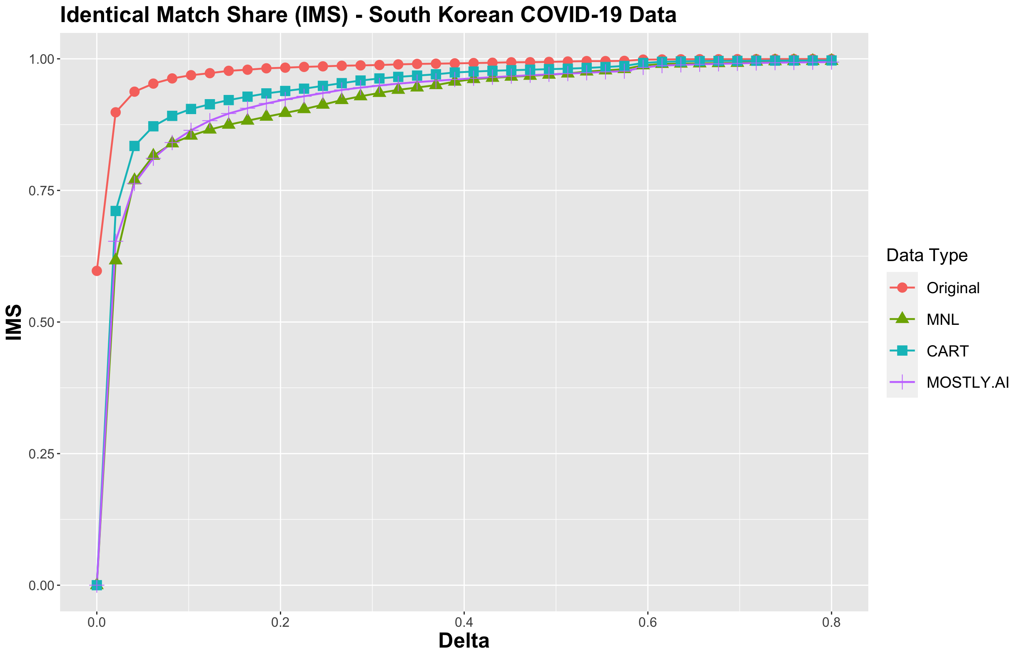
All Methods Produce Legally Anonymous Synthetic Data
Example: The Identical Match Share (IMS) is the proportion of synthetic records that are “identical” to their nearest neighbor confidential record.
But does legally anonymous synthetic data protect against attribute disclosure?

Slide 17
Attribute Disclosure: What is the largest increase in probability that an adversary can predict the value of State after obtaining the synthetic data?
$e=$ Latitude, Longitude, Sex, Age of target record
$p\left(S_{j}=s_{j}^{∗} \right| e )=\frac{152}{9583}≈0.016$(based on WHO data)
$p\left(S_{j}=s_{j}^{∗} \right| Z,e)=proportion$ of synthetic records in $δ−$neighborhood with State $=s_{j}^{∗}$
max $\frac{p\left(S_{j}=s_{j}^{∗} | Z, e\right)}{p\left(S_{j}=s_{j}^{∗} | e\right)}, j=1,…,N$,
where $s_{j}^{∗}$ is the value of State for the $j$th record and $e$ is the external information available to the adversary.

Slide 18
Attribute Disclosure Illustration
The Adversary considers synthetic records within $δ_{AD}$ of the target record for Latitude/Longitude, with exact match for Sex and Age.
$$δ_{AD}$$
$$p\left(S_{j}=s_{j}^{∗} \right| Z,e)=\text{6/14}$$
$\text{(}\text{6/14}$)/0.016 = 26.8

Slide 19
Legal Anonymity Does Not Guarantee Protection Against Attribute Disclosure

Slide 20
Solution: ‘Local’ Sampling of New Synthetic Records
Sample additional synthetic locations from the GMM
$$δ_{AD}$$
$$p\left(S_{j}=s_{j}^{∗} \right| Z,e)=\text{6}/38$$
$0.16/$0.016 = 10

Slide 21
Legal Anonymity Does Not Guarantee Protection Against Attribute Disclosure
Bounded increase by 10

Slide 22
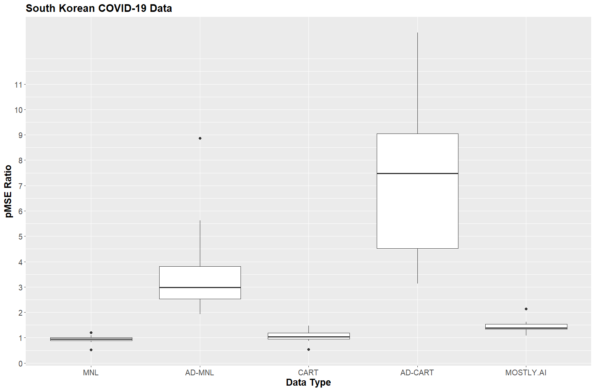
Global Utility: Attribute disclosure protection increases the pMSE Ratio

Slide 23
Analysis-Specific Utility: Do the synthetic data sets maintain the inferential conclusions of the confidential data?
$$\ln\left(\frac{p\left(State_{i}=s \right| X_{i})}{1 −p\left(State_{i}=s \right| X_{i})}\right)=β_{0}+β_{1}Latitude_{i}+β_{2}Longitude_{i}+β_{3}Sex_{i}+β_{4}Age_{i}$$
We measure the Sign, Significance, and Overlap (SSO) (Barrientos et al., 2024) of the confidential and synthetic point estimates and confidence intervals…

Slide 24
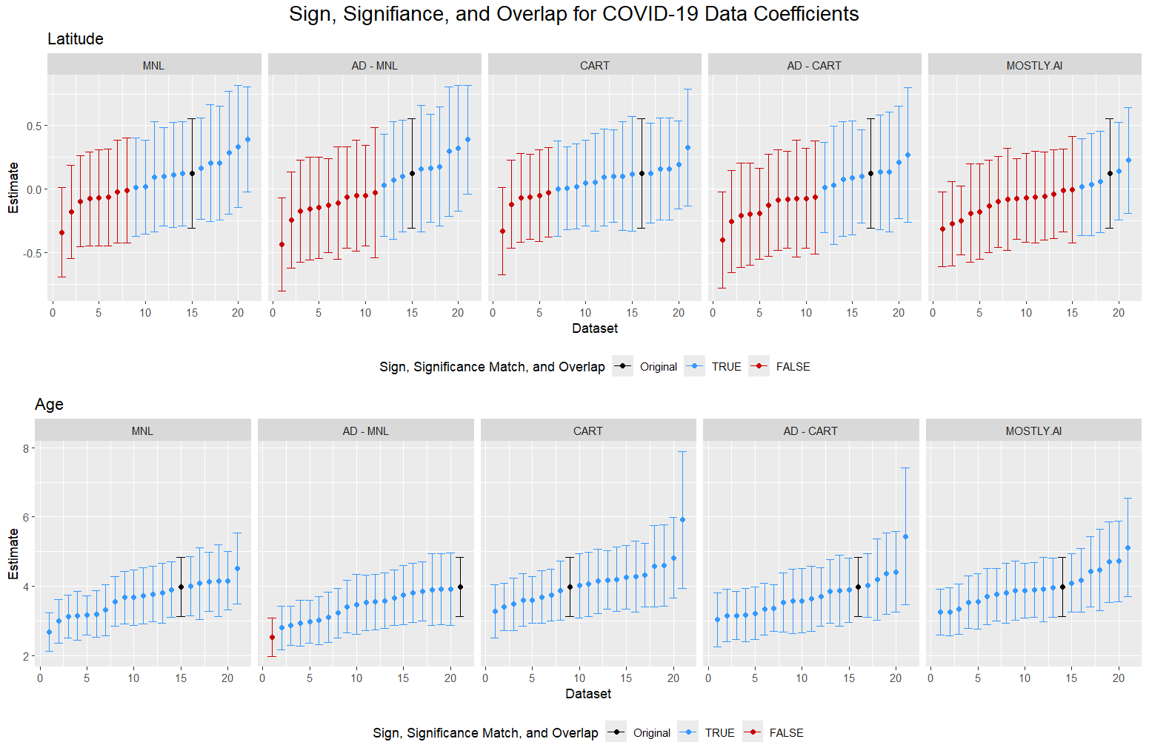
Notes:
Note: attribute disclosure protection did not have a significant effect on our ability to make inference using the synthetic data!

Slide 25
Conclusions
The optimized sequential synthesis methods (GMM, CART, and MNL-based) can produce legally anonymous synthetic data
Legally anonymous synthetic data does not guarantee protection against attribute disclosure
The utility of the optimized sequential synthesis methods is on par with that of the MOSTLY.AI method…and we can provide additional protection against attribute disclosure

Slide 26
Thank You!
Contact:
Cameron Bale
Assistant Professor of Marketing
BYU Marriott School of Business
cameron.bale@byu.edu

Slide 27
References
Barrientos, A. F., Williams, A. R., Snoke, J., & Bowen, C. M. (2024). A Feasibility Study of Differentially Private Summary Statistics and Regression Analyses with Evaluations on Administrative and Survey Data. Journal of the American Statistical Association, 119(545), 52-65.
Bowen, C. M., Bryant, V., Burman, L., Czajka, J., Khitatrakun, S., MacDonald, G., ... & Zwiefel, N. (2022, September). Synthetic individual income tax data: Methodology, utility, and privacy implications. In International Conference on Privacy in Statistical Databases (pp. 191-204). Cham: Springer International Publishing.
Cohen, A., & Nissim, K. (2020). Towards formalizing the GDPR’s notion of singling out. Proceedings of the National Academy of Sciences, 117(15), 8344-8352.
Drechsler, J., & Hu, J. (2021). Synthesizing geocodes to facilitate access to detailed geographical information in large-scale administrative data. Journal of Survey Statistics and Methodology, 9(3), 523-548.

Slide 28
References (pt. 2)
Nowok, B., Raab, G. M., & Dibben, C. (2016). synthpop: Bespoke creation of synthetic data in R. Journal of statistical software, 74, 1-26.
Schneider, M. J., Hu, J., Mankad, S., & Bale, C. D. (2023). Protecting the anonymity of online users through Bayesian data synthesis. Expert Systems with Applications, 216, 119409.
Snoke, J., Raab, G. M., Nowok, B., Dibben, C., & Slavkovic, A. (2018). General and specific utility measures for synthetic data. Journal of the Royal Statistical Society Series A: Statistics in Society, 181(3), 663-688.

Slide 29
Appendix

Slide 30
European Data Protection Board
“Anonymisation refers to the use of a set of techniques in order to remove the ability to link the data with an identified or identifiable natural person against any ‘reasonable’ effort. This ‘reasonability test’ must take into account both objective aspects (time, technical means) and contextual elements that may vary case by case (rarity of a phenomenon including population density, nature and volume of data).” (Guidelines 04/2020 on the use of location data and contact tracing tools in the context of the COVID-19 outbreak)
Do attribute disclosure attacks constitute a reasonable effort? If so, what are the assumptions we should make regarding the context of the attack (e.g., what side information is available to an adversary)?

Slide 31
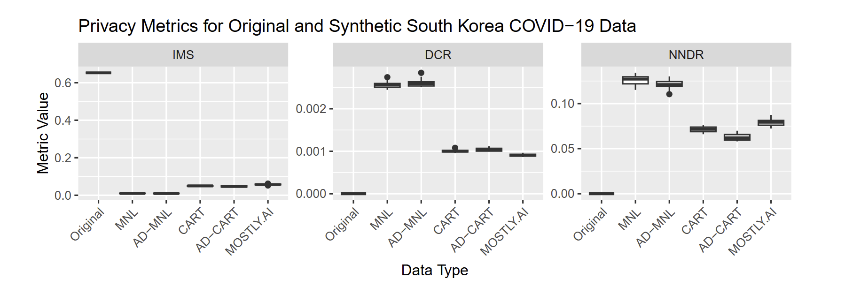
All Methods Produce Legally Anonymous Synthetic Data

Slide 32
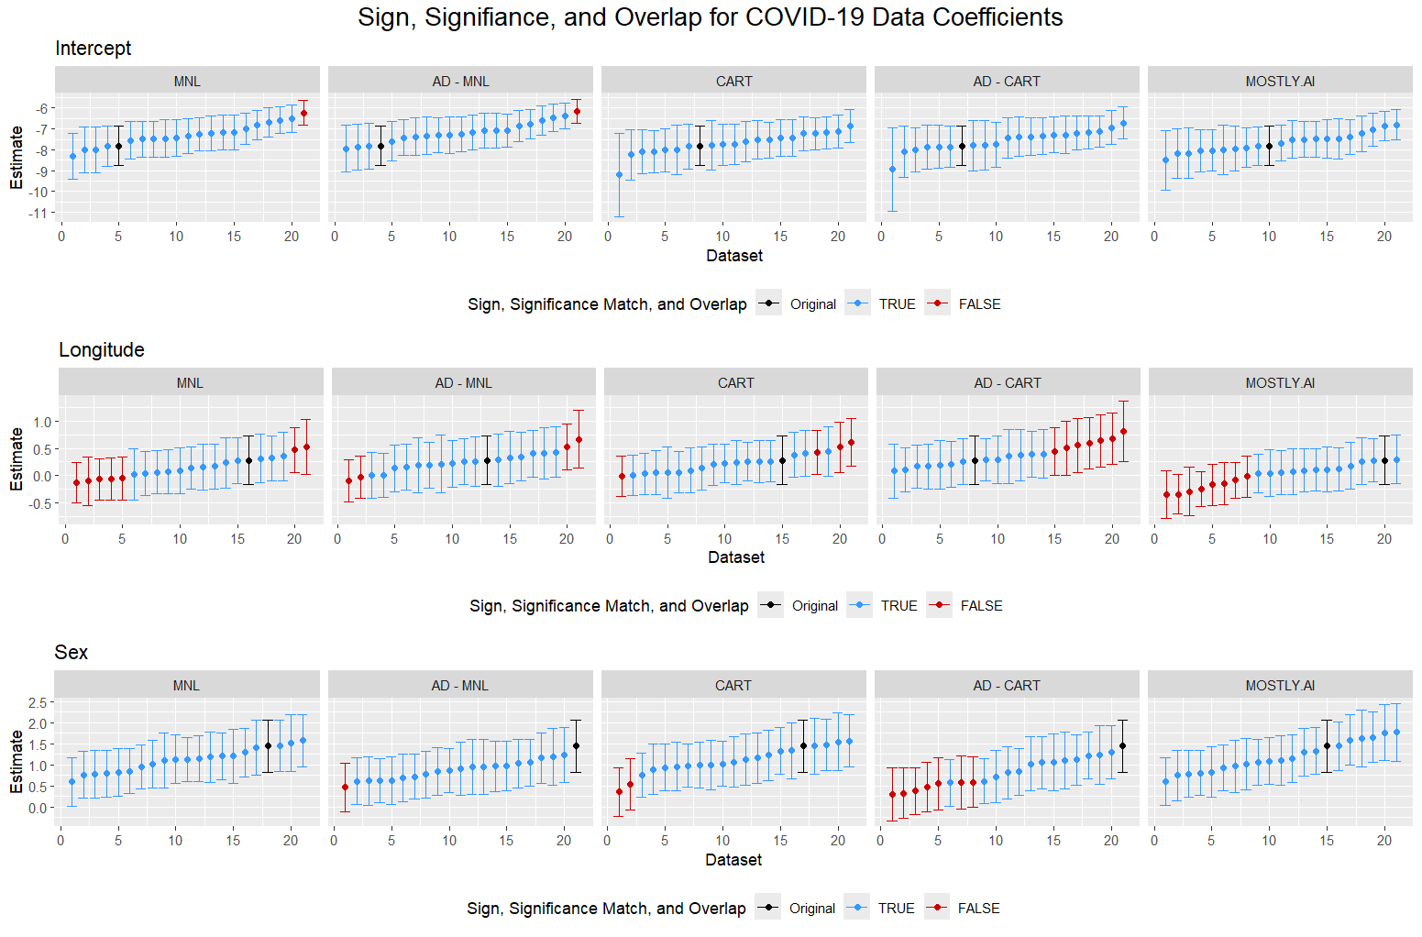

Slide 33
Future Directions
Optimize synthetic data for other goals (e.g., maximize analysis-specific utility subject to privacy constraints)
Test optimized synthesis method performance using other measures of distributional similarity (e.g., SPEC from Bowen et al. (2021), multivariate Hellinger distance from El Emam et al. (2022))
Different compositions of synthesis models (e.g., all CART models)
Further exploration of privacy attacks against legally anonymous synthetic data

